Slide 1
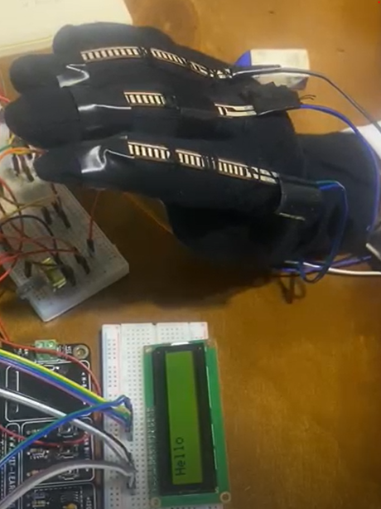
Interpreter Glove
Presented by:
Sherry Ghobrial
Peter Adel Gaber
Ashrakat Ihab

Slide 2
TABLE OF CONTENTS
01
PROJECT BRIEFING
02
FLOWCHART
03
PROJECT SOFTWARE
04
PROJECT HARDWARE

Slide 3

01.
PROJECT BREIFING
Introduction and key components

Slide 4
INTRODUCTION
The wearable device has sensors that run along the four fingers and thumb to recognize each sign language word, phrase, or letter. This project aims to greatly ease communication for those with disabilities.

Slide 5
KEY components
ATMEGA32
LCD
Flex sensor
External EEPROM
Fixed resistance
TWI
The microcontroller
2*16 LCD 2.6 inches
5 flex sensors ranging between 30kΩ- 100kΩ
to store the signs and corresponding signals
5 of 36kΩ resistance
To communicate with the external EEPROM

Slide 6
Abstraction Layers
APPLICATION
HAL
MCAL
Contains the application functions that store, compare and display the signs.
Service
Contains the file for BIT-MATH and STD-TYPES.
Contains the LCD and EEPROM drivers.
Contains our microcontroller drivers: DIO, ADC, TWI.

Slide 7
02.
FLOWCHART

Slide 8
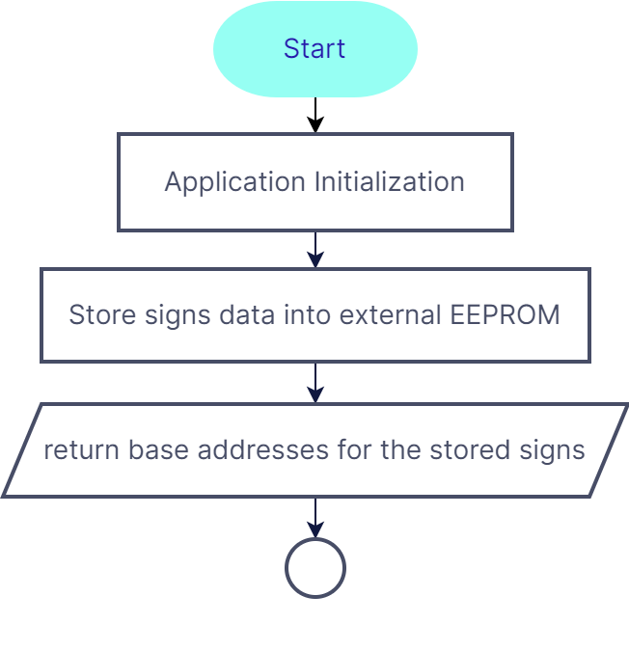
Flowchart

Slide 9
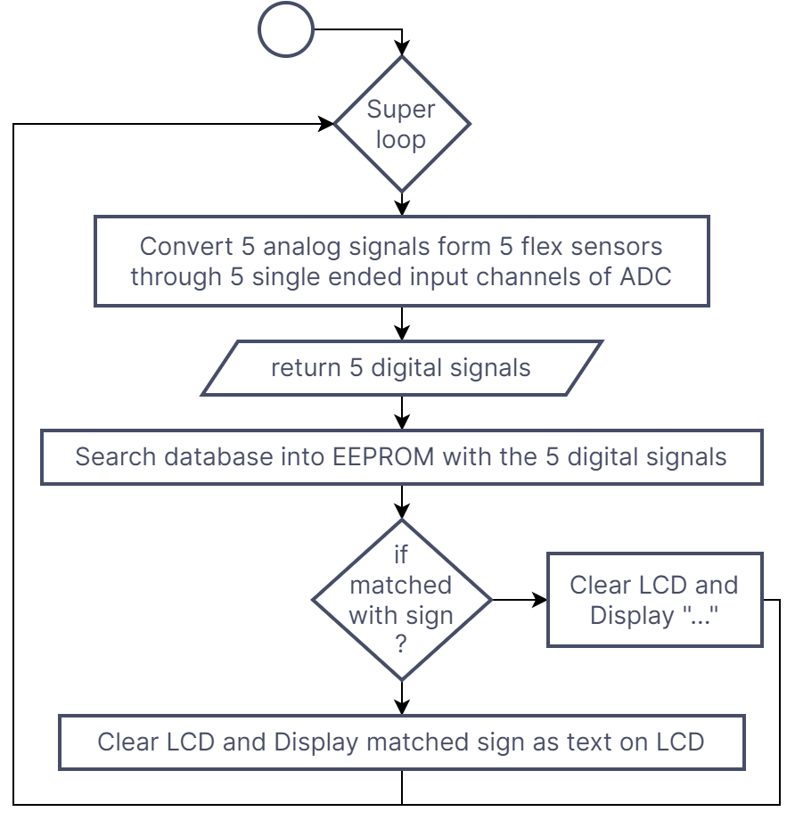
Flowchart

Slide 10
03.
SOFTWARE
Algorithm and Stored Signs

Slide 11
U16 array of base add. of each sign signals [15] | U16 Array of base Add. of the 15 Signs names
Address signal 1 | 0x0000
Address signal 2 | 0x0006
Address signal 3 and so on | 0x000f
Two arrays to be built in main.c to hold the base addresses of the sign names and corresponding signal values.
In EEPROM, the sign names as strings as illustrated in the table.
After storing, the ADC reads sensor signals which are compared to stored signals.
Once they match, the sign is displayed on the LCD.
Address 0x0000 | Y
 | E
 | S
Address 0x0003 | \0
Notes:
Peace
I love you
You
Good work
I watching you
Poten
Bathroom
That Is awoms
play
No

Slide 12
15 stored signs are shown below.
The interpreter glove is calibrated according to the user’s hand movements and is recalibrated for different users.
Awesome
Have a good life
Yes
O.K.
I’m watching you
Peace
You
Perfect
No
I love you
Hello
Bathroom
Seven
I do love you
Play

Slide 13
04.
HARDWARE
Resistance selection and wiring diagram

Slide 14
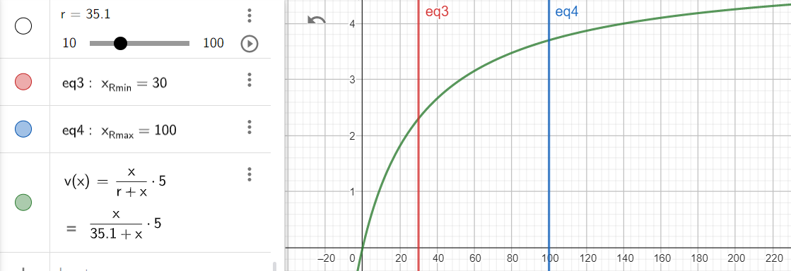
Resistance selection
Our flex sensor's resistance varies from 30kΩ, which represents the flat position, to about 100kΩ, which represents the maximum bending.
The green equation represent the voltage diver equation where x is the resistance of the flex sensor and r is the fixed resistance

Slide 15
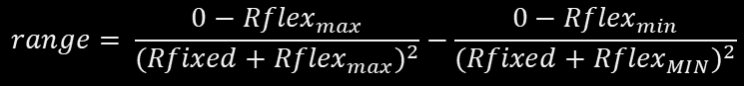
Resistance selection
It is necessary to differentiate the voltage divider equation in order to determine the maximum range between v max and v min. then To determine the r, let's set the result to zero. So the best R =34.856KΩ
$$range= \frac{0−{Rflex}_{max}}{{(Rfixed+{Rflex}_{max})}^{2}}−\frac{0−{Rflex}_{min}}{{(Rfixed+{Rflex}_{MIN})}^{2}}$$

Slide 16
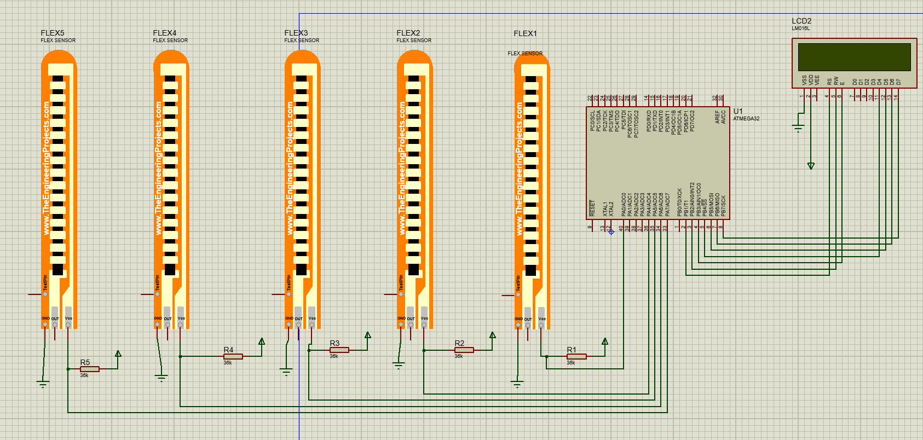
Wiring diagram
Do you know what could help you make your point clear?
Lists like this one:
They’re simple
You can organize your ideas clearly
You’ll never forget to buy milk!
And the most important thing: the audience won’t miss the point of your presentation

Slide 17
LAUNCH

Slide 18
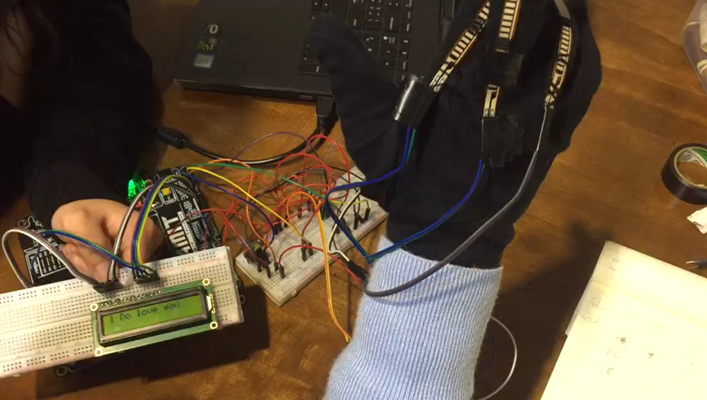

Project DEMO

Slide 19
Project DEMO

Slide 20
THANK YOU

